Slide 1
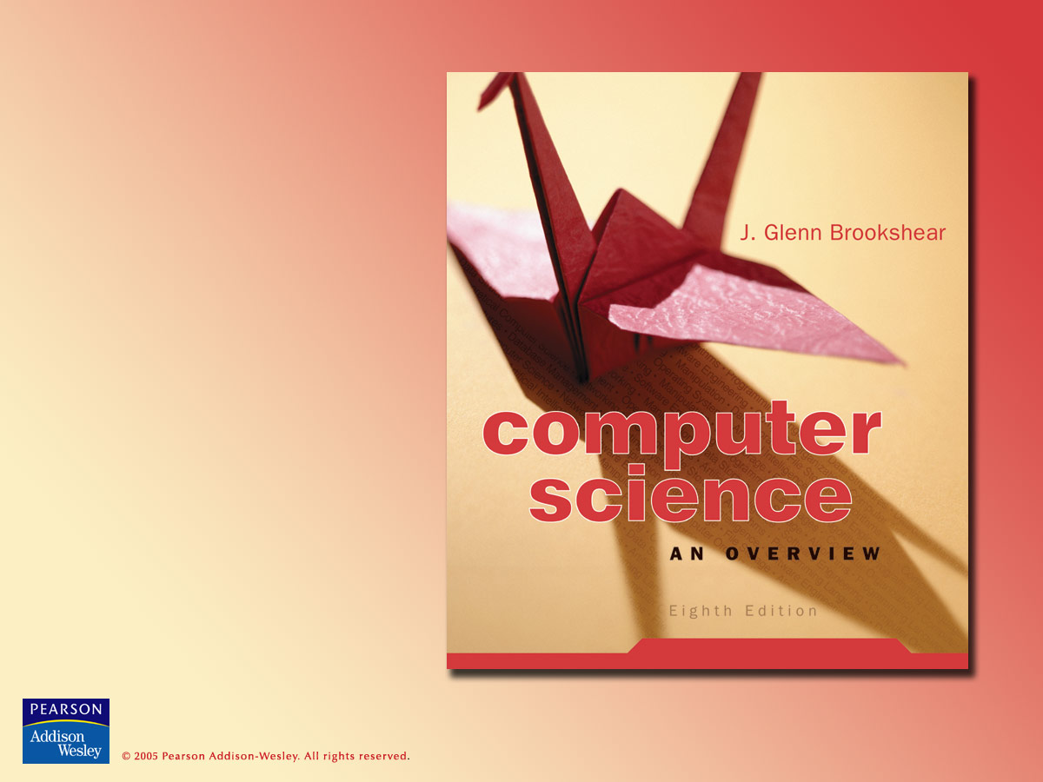
Chapter 1
Data Storage

Slide 2

Chapter 1: Data Storage
1.1 Bits and Their Storage
1.2 Main Memory
1.3 Mass Storage
1.4 Representing Information as Bit Patterns
1.5 The Binary System
1.6 Storing Integers

Slide 3
Chapter 1: Data Storage (continued)
1.7 Storing Fractions
1.8 Data Compression
1.9 Communications Errors

Slide 4
Bits and their meaning
Bit = Binary Digit = a symbol whose meaning depends on the application at hand.
Some possible meanings for a single bit
  Numeric value (1 or 0)
  Boolean value (true or false)
  Voltage (high or low)

Slide 5
Bit patterns
All data stored in a computer are represented by patterns of bits:
  Numbers
  Text characters
  Images
  Sound
  Anything else…

Slide 6
Boolean operations
Boolean operation = any operation that manipulates one or more true/false values
  Can be used to operate on bits
Specific operations
  AND
  OR
  XOR
  NOT

Slide 7
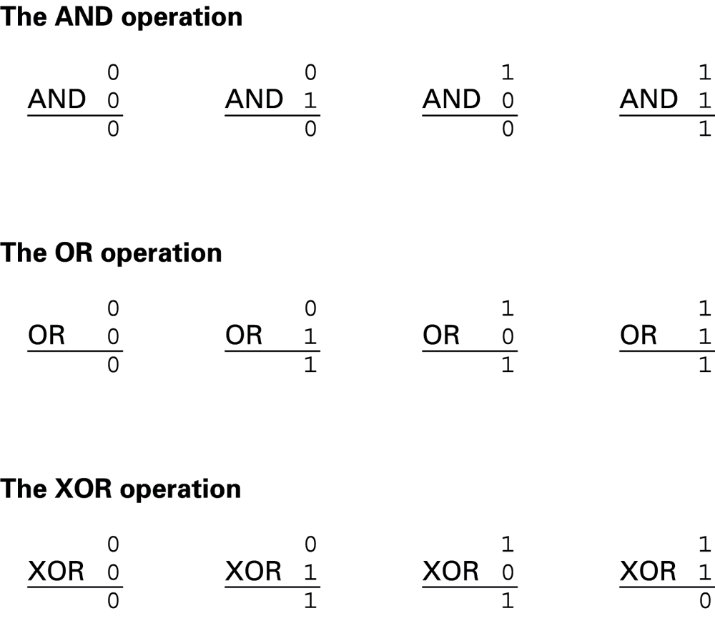
Figure 1.1 The Boolean operations AND, OR, and XOR (exclusive or)

Slide 8
Gates
Gates = devices that produce the outputs of Boolean operations when given the operations’ input values
  Often implemented as electronic circuits
  Provide the building blocks from which computers are constructed

Slide 9
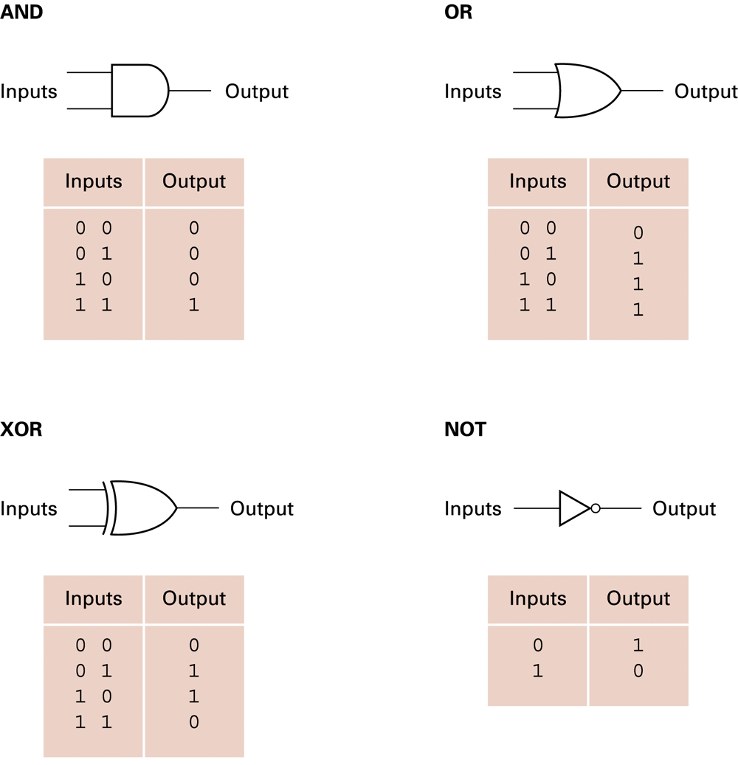
Figure 1.2 A pictorial representation of AND, OR, XOR, and NOT gates as well as their input and output values

Slide 10
Flip-flops
Flip-flop = a circuit built from gates that can store one bit of data.
  Has an input line which sets its stored value to 1
  Has an input line which sets its stored value to 0
  While both input lines are 0, the most recently stored value is preserved

Slide 11
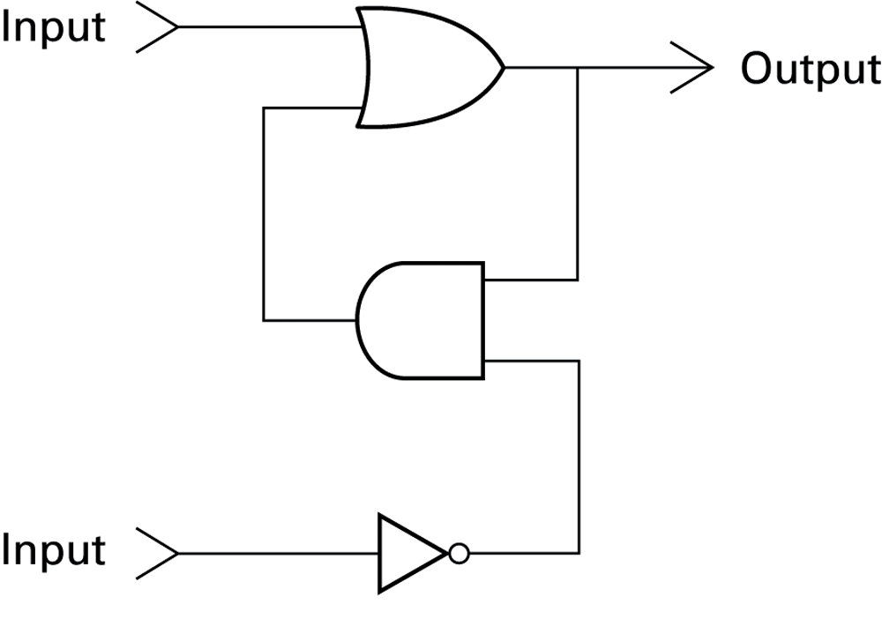
Figure 1.3 A simple flip-flop circuit

Slide 12
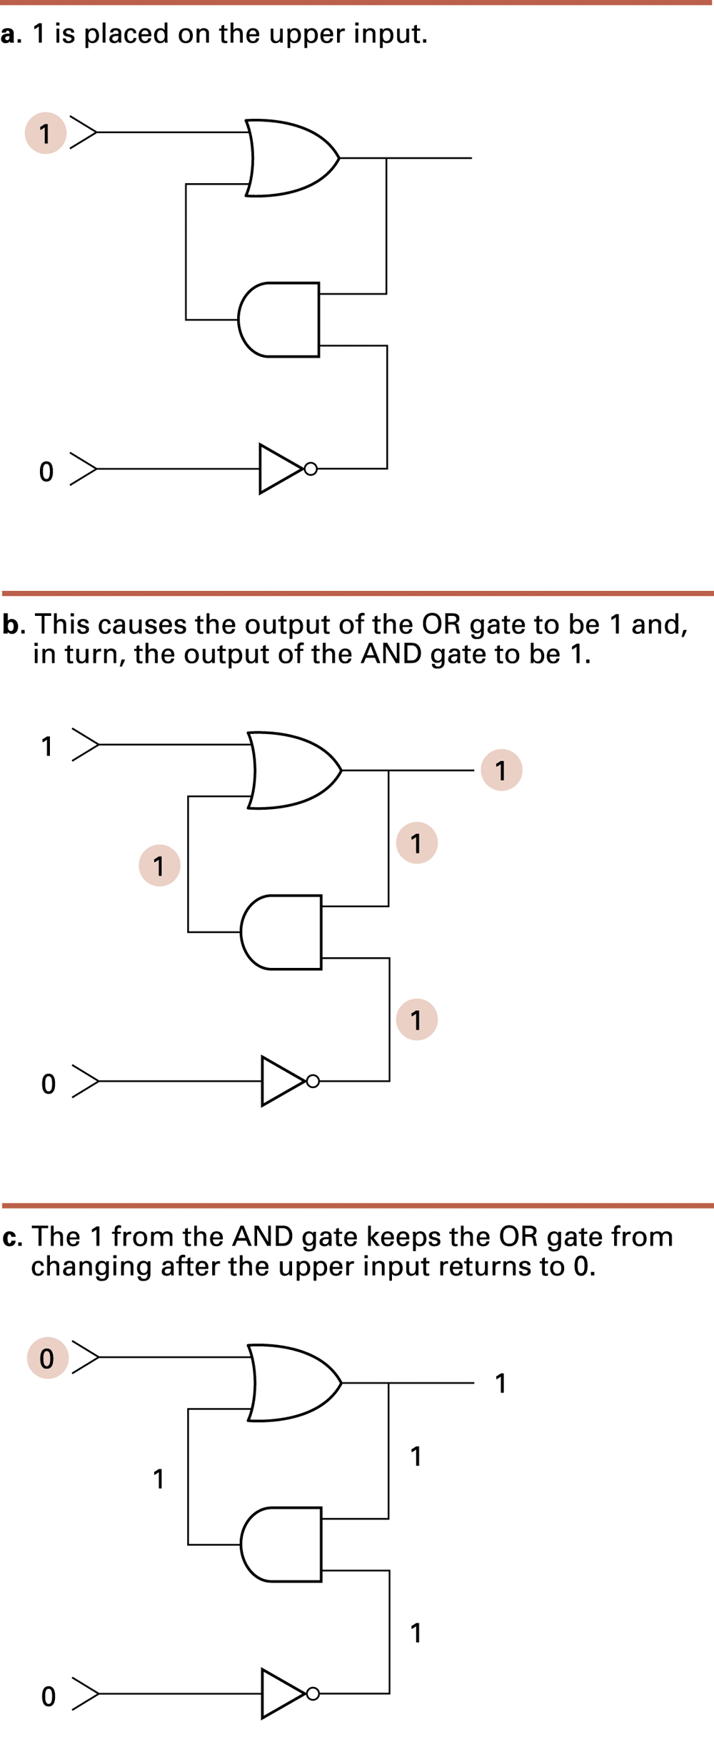
Figure 1.4 Setting the output of a flip-flop to 1

Slide 13
Figure 1.4 Setting the output of a flip-flop to 1 (cont’d)

Slide 14
Figure 1.4 Setting the output of a flip-flop to 1 (cont’d)

Slide 15
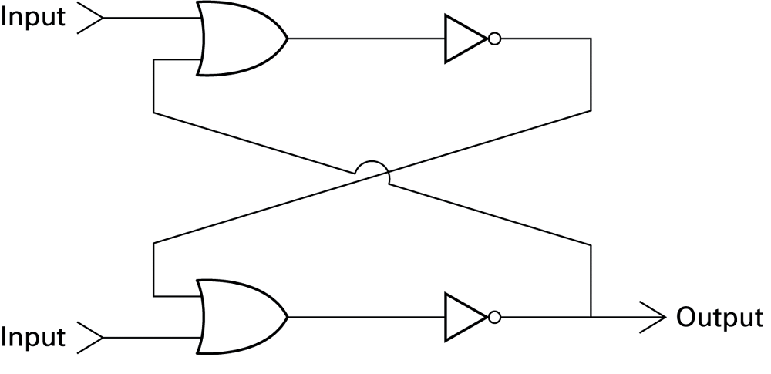
Figure 1.5 Another way of constructing a flip-flop

Slide 16
Other storage techniques
Dynamic memory – must be replenished periodically – Example: capacitors
Volatile memory – holds its value until the power is turned off – Example: flip-flops
Non-volatile memory – holds its value after the power is off – Example: magnetic storage
Read-only memory (ROM) – never changes – Examples: flash memory, compact disks

Slide 17
Hexadecimal notation
Hexadecimal notation = a shorthand notation for streams of bits.
  Stream = a long string of bits.
  Long bit streams are difficult to make sense of.
  The lengths of most bit streams used in a machine are multiples of four.
  Hexadecimal notation is more compact.
    Less error-prone to manually read, copy, or write

Slide 18
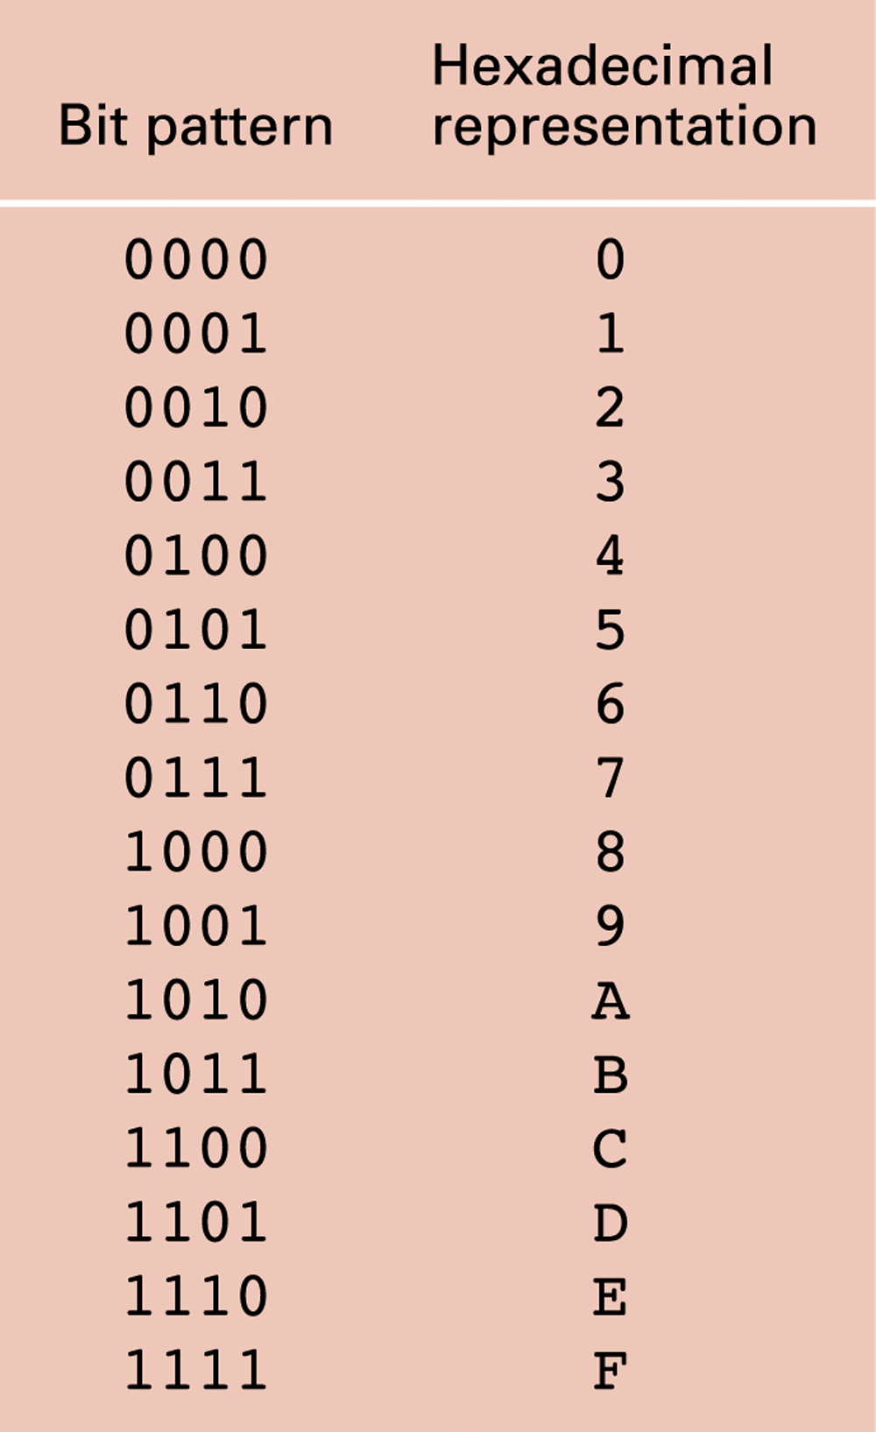
Figure 1.6 The hexadecimal coding system

Slide 19
Main memory: cells
Cells = manageable units (typically 8 bits) into which a computer’s main memory is arranged.
Byte = a string of 8 bits.
High-order end = the left end of the conceptual row in which the contents of a cell are laid out.
Low-order end = the right end of the conceptual row in which the contents of a cell are laid out.
  Least significant bit = the last bit at the low-order end.

Slide 20
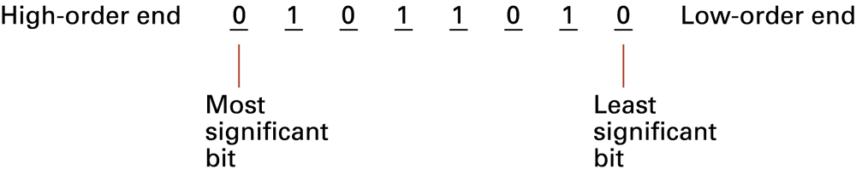
Figure 1.7 The organization of a byte-size memory cell

Slide 21
Main memory addresses
Address = a “name” to uniquely identify one cell in the computer’s main memory
The names for cells in a computer are consecutive numbers, usually starting at zero
Cells have an order: “previous cell” and “next cell” have reasonable meanings
Random Access Memory = memory where any cell can be accessed independently

Slide 22
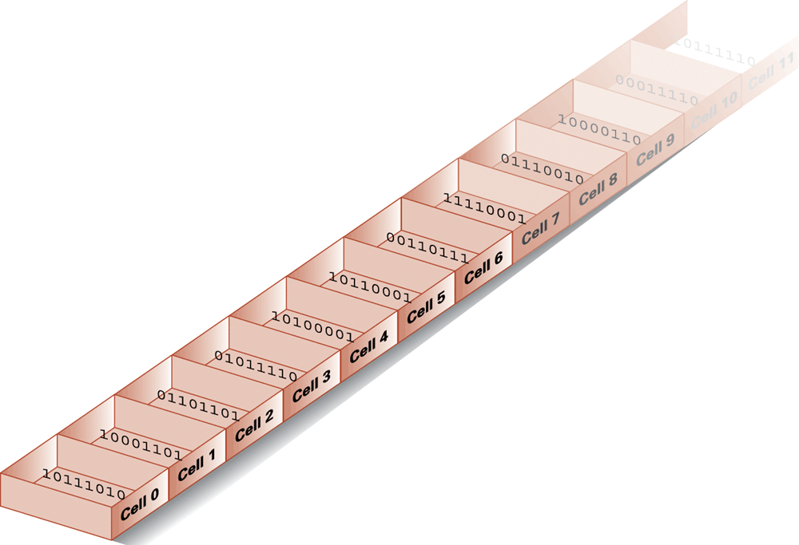
Figure 1.8 Memory cells arranged by address

Slide 23
Measuring memory capacity: Not quite like the metric system
“Kilo-” normally means 1,000;
Kilobyte = 2¹⁰ = 1024
“Mega-” normally means 1,000,000;
Megabyte = 2²⁰ = 1,048,576
“Giga-” normally means 1,000,000,000;
Megabyte = 2³⁰ = 1,073,741,824

Slide 24
Mass Storage Systems
Non-volatile; data remains when computer is off
Usually much bigger than main memory
Usually rotating disks
  Hard disk, floppy disk, CD-ROM
  Much slower than main memory
    Data access must wait for seek time (head positioning)
    Data access must wait for rotational latency

Slide 25
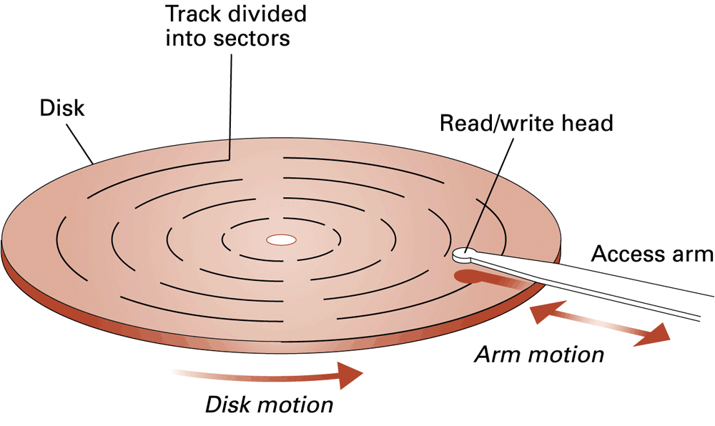
Figure 1.9 A disk storage system

Slide 26
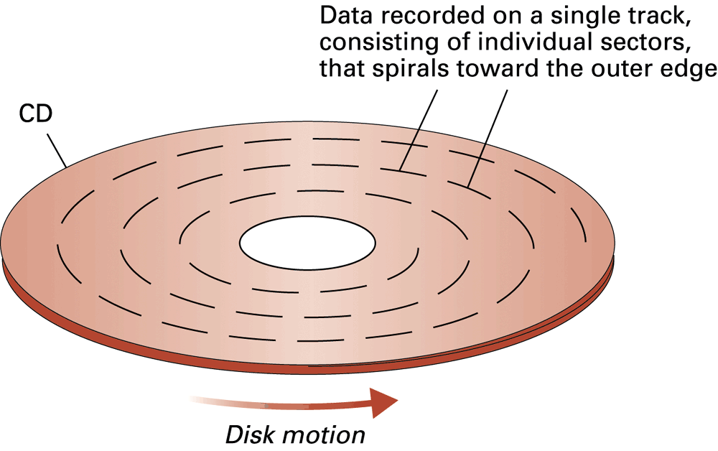
Figure 1.10 CD storage format

Slide 27
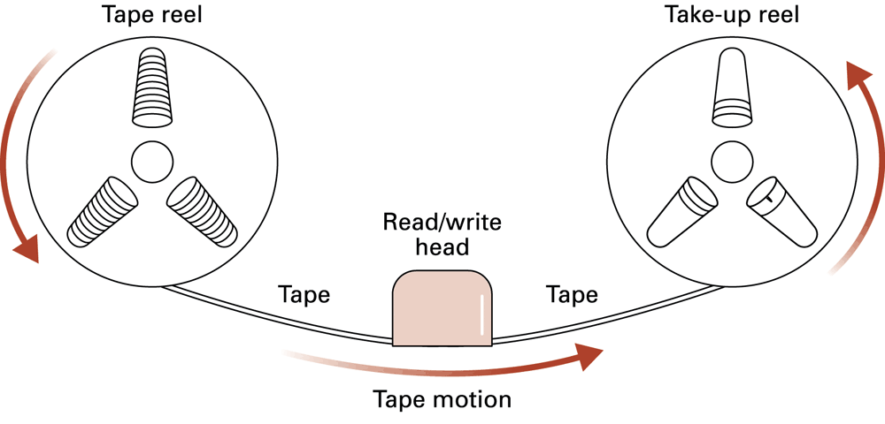
Figure 1.11 A magnetic tape storage mechanism

Slide 28
Files
File = the unit of data stored on a mass storage system.
  Logical record and Field = natural groups of data within a file
Physical record = a block of data conforming to the physical characteristics of the storage device.
Buffer = main memory area sometimes set aside for assembling logical records or fields of a file

Slide 29
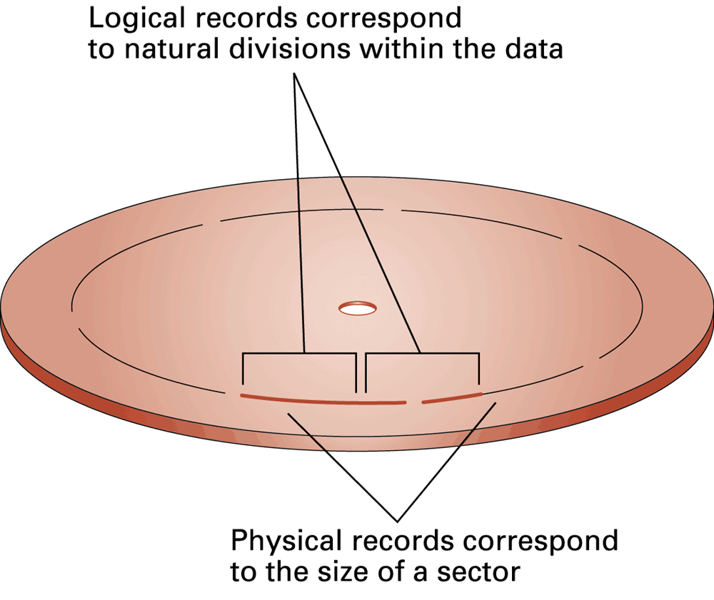
Figure 1.12 Logical records versus physical records on a disk

Slide 30
Figure 1.13 The message “Hello.” in ASCII

Slide 31
Representing text
Each printable character (letter, punctuation, etc.) is assigned a unique bit pattern.
  ASCII = 7-bit values for most symbols used in written English text
  Unicode = 16-bit values for most symbols used in most world languages today
  ISO proposed standard = 32-bit values

Slide 32
Representing numeric values
Binary notation – uses bits to represent a number in base two
Limitations of computer representations of numeric values
  Overflow – happens when a number is too big to be represented
  Truncation – happens when a number is between two representable numbers

Slide 33
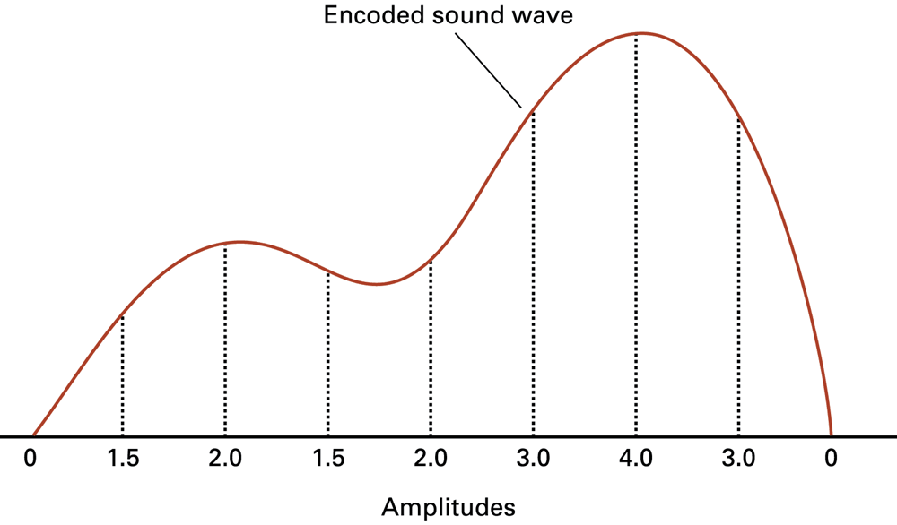
Figure 1.14 The sound wave represented by the sequence 0, 1.5, 2.0, 1.5, 2.0, 3.0, 4.0, 3.0, 0

Slide 34
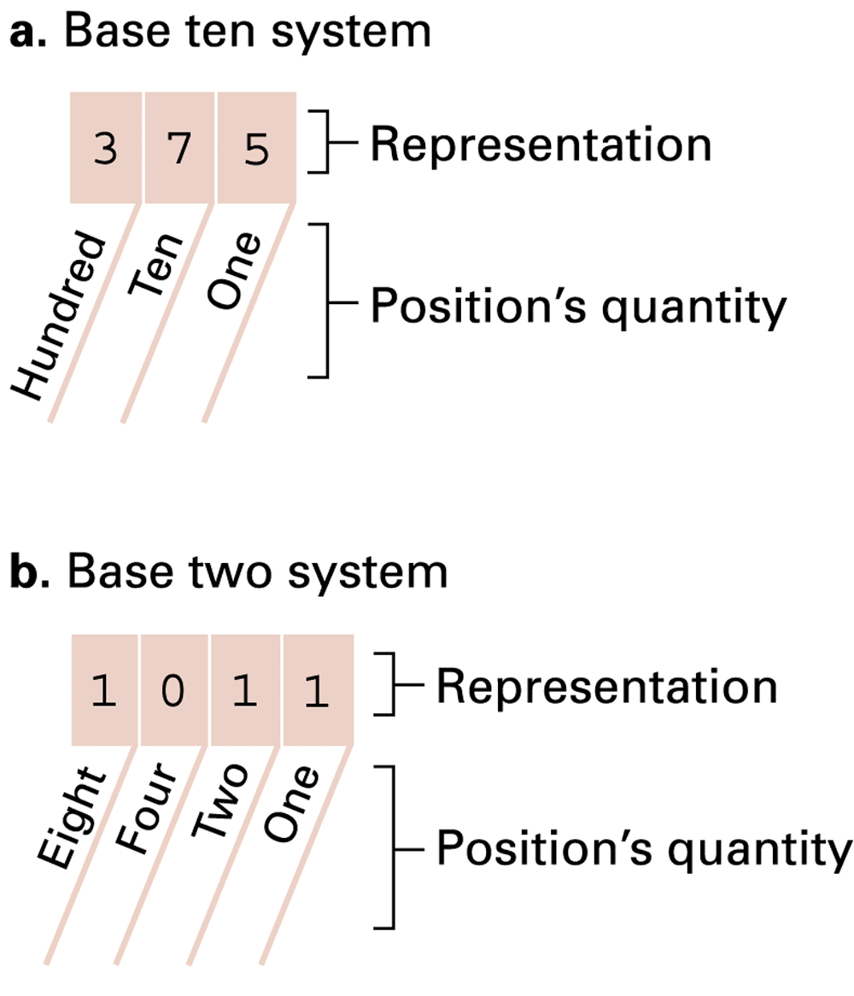
Figure 1.15 The base ten and binary systems

Slide 35
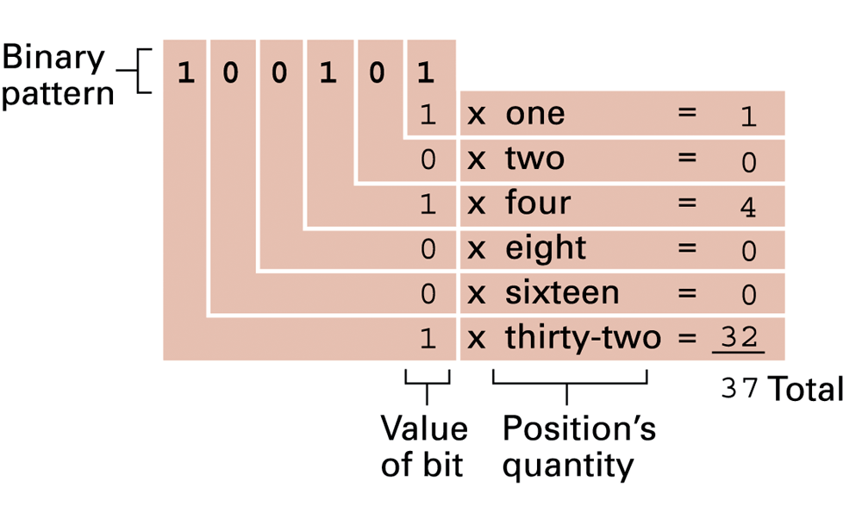
Figure 1.16 Decoding the binary representation 100101

Slide 36
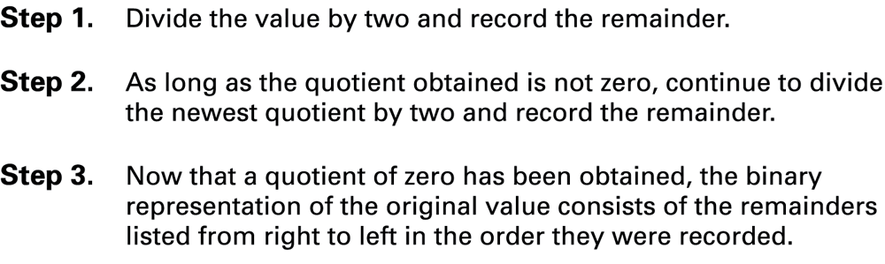
Figure 1.17 An algorithm for finding the binary representation of a positive integer

Slide 37
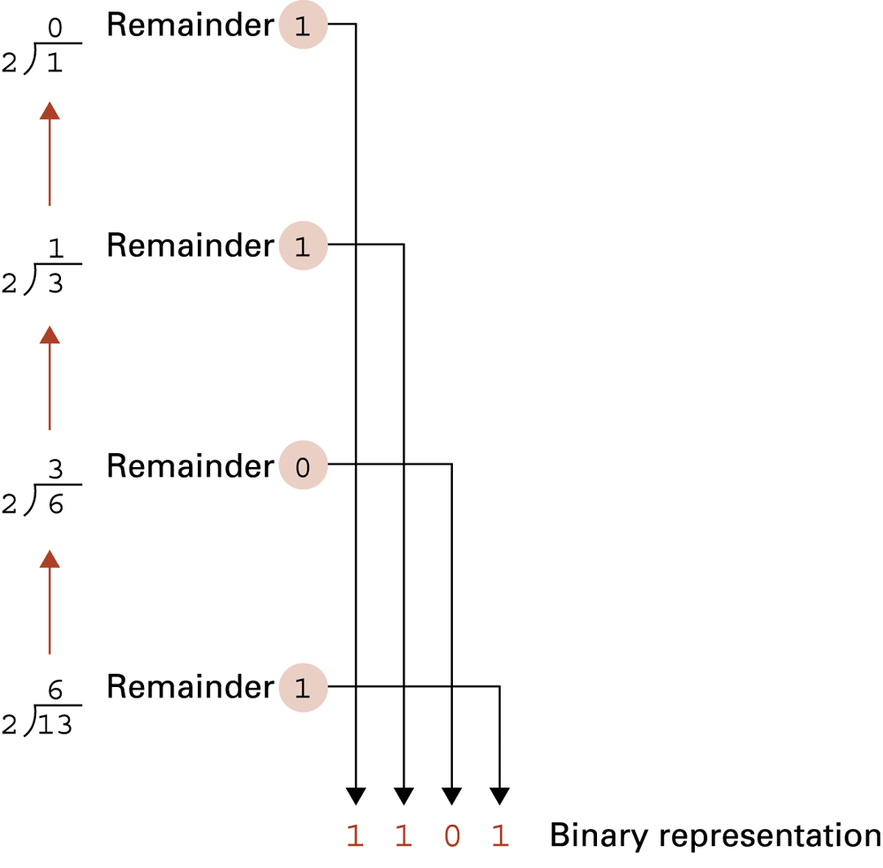
Figure 1.18 Applying the algorithm in Figure 1.15 to obtain the binary representation of thirteen

Slide 38
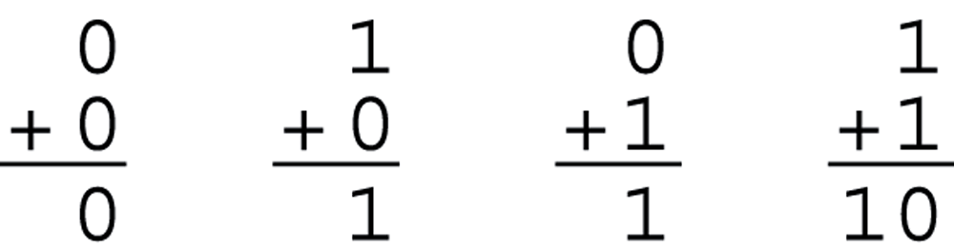
Figure 1.19 The binary addition facts

Slide 39
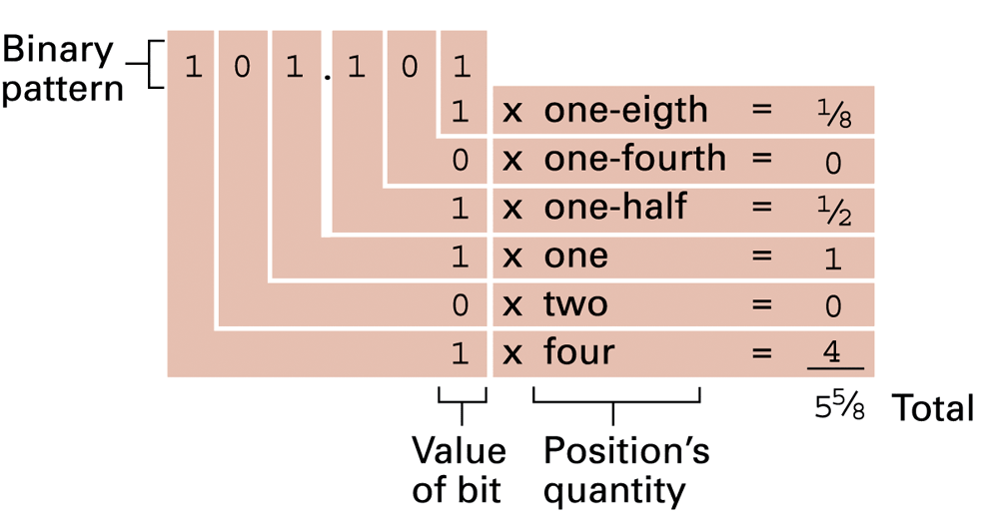
Figure 1.20 Decoding the binary representation 101.101

Slide 40
Representing Integers
Unsigned integers can be represented in base two
Signed integers = numbers that can be positive or negative
  Two’s complement notation = the most popular representation
  Excess notation = another less popular representation

Slide 41
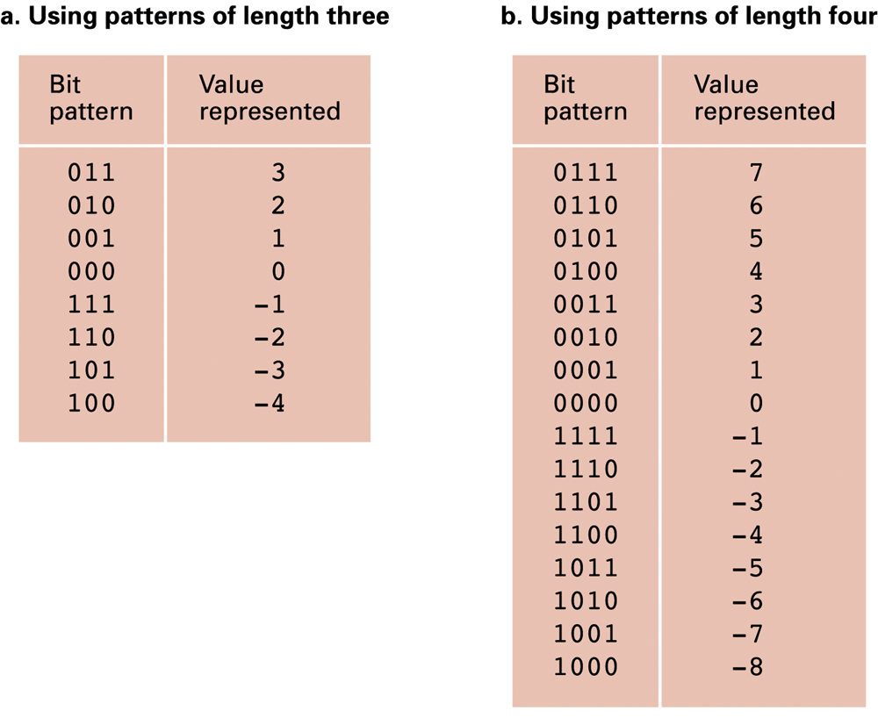
Figure 1.21 Two’s complement notation systems

Slide 42
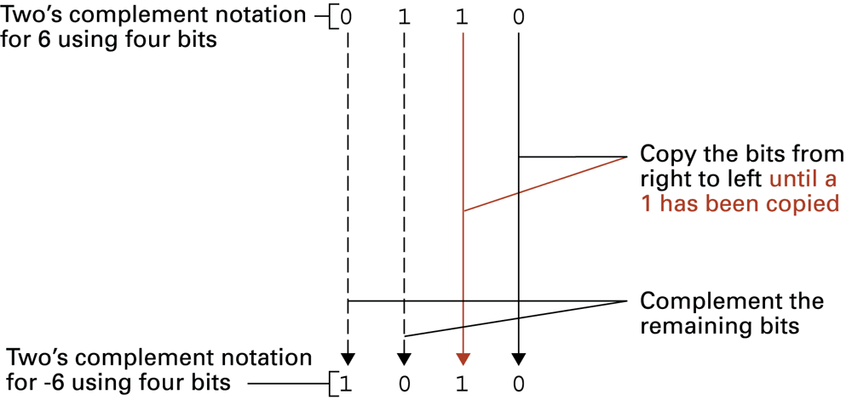
Figure 1.22 Coding the value -6 in two’s complement notation using four bits

Slide 43
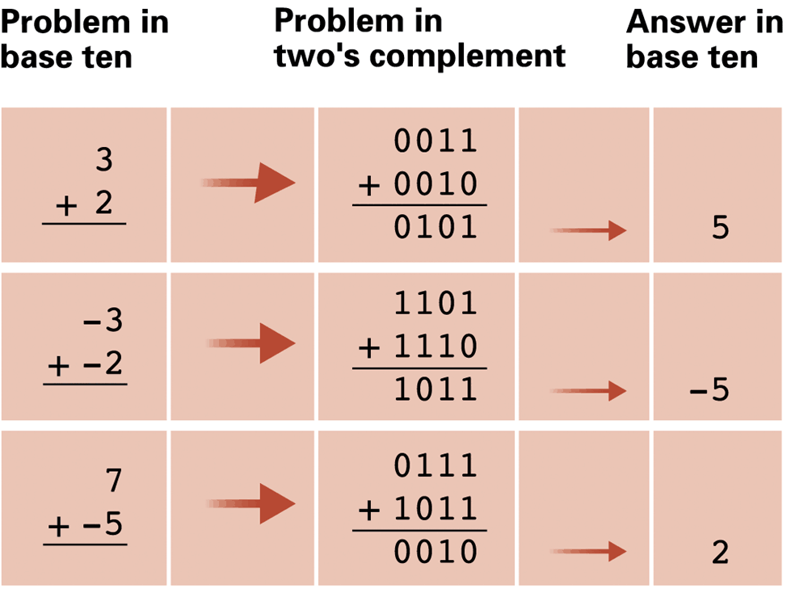
Figure 1.23 Addition problems converted to two’s complement notation

Slide 44
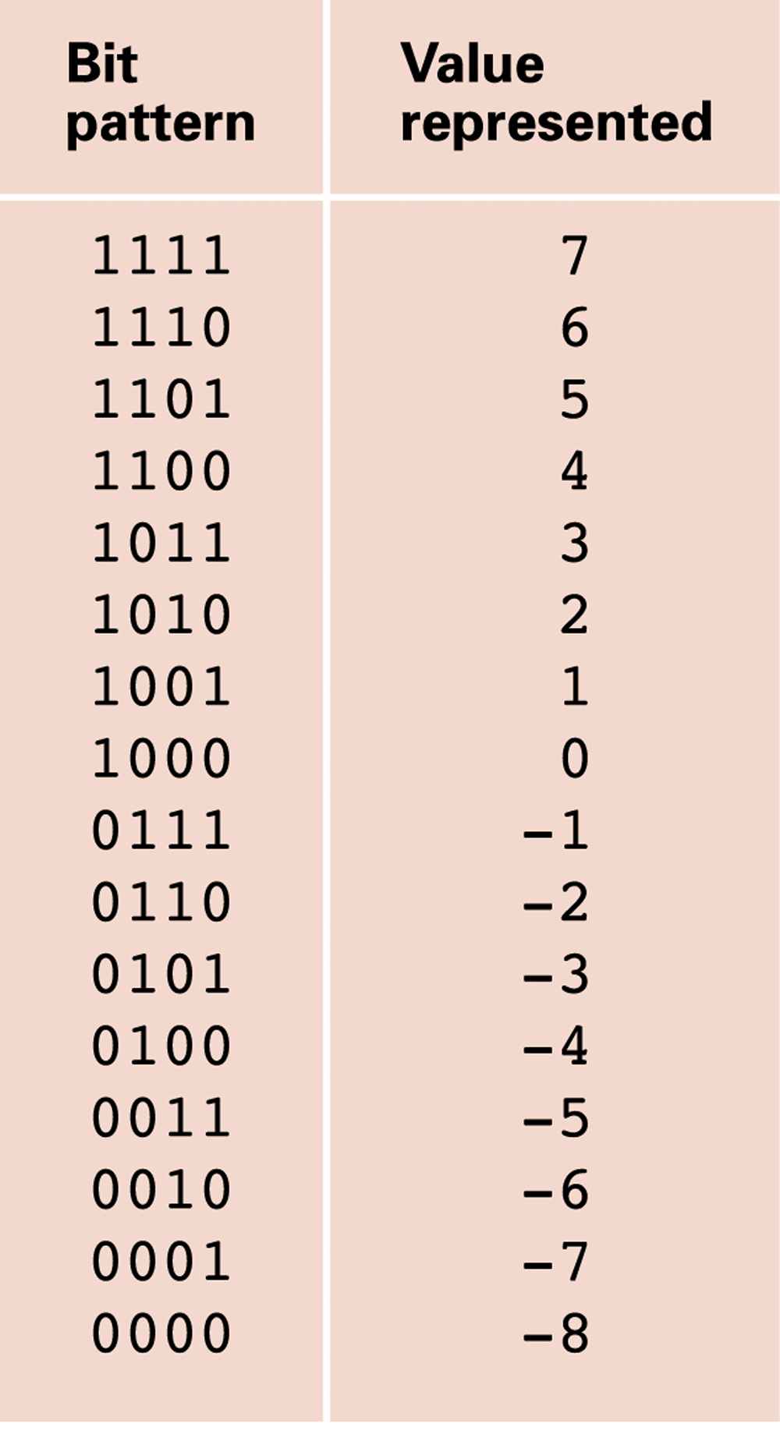
Figure 1.24 An excess eight conversion table

Slide 45
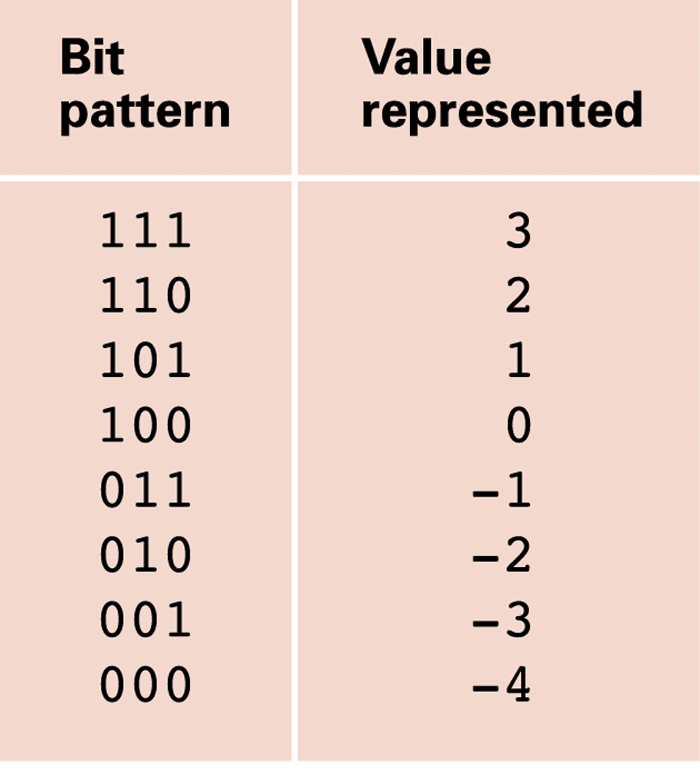
Figure 1.25 An excess notation system using bit patterns of length three

Slide 46
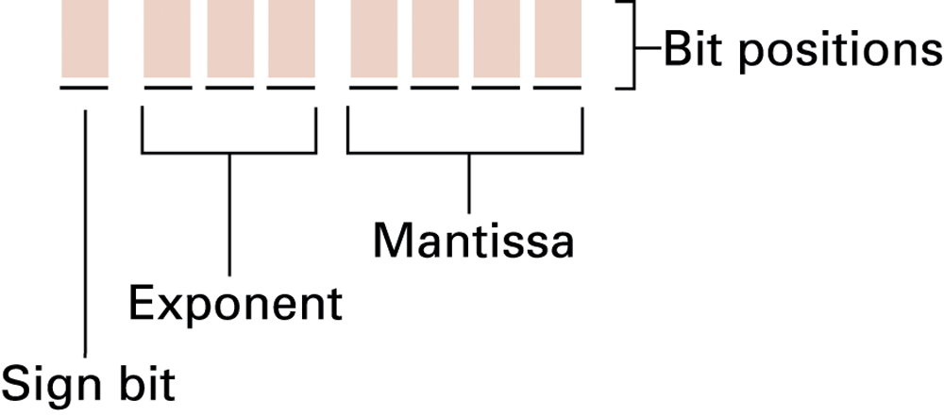
Figure 1.26 Floating-point notation components

Slide 47
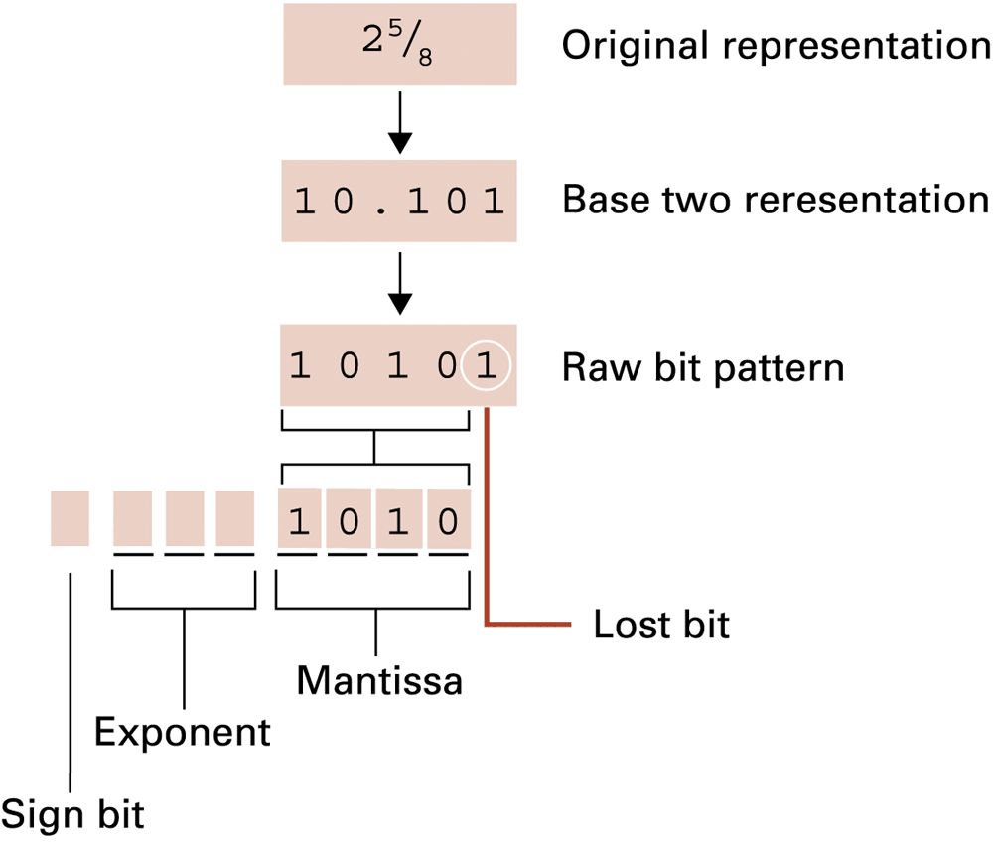
Figure 1.27 Coding the value 25⁄8

Slide 48
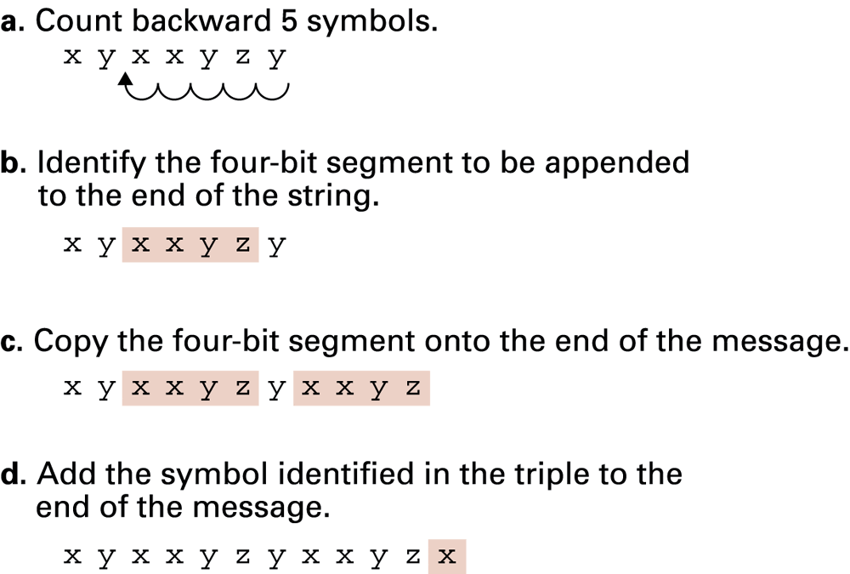
Figure 1.28 Decompressing xyxxyzy (5, 4, x)

Slide 49
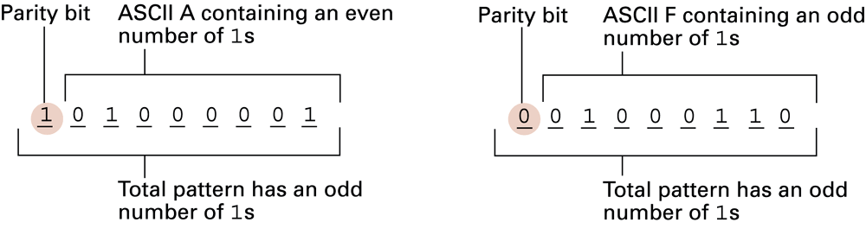
Figure 1.29 The ASCII codes for the letters A and F adjusted for odd parity

Slide 50
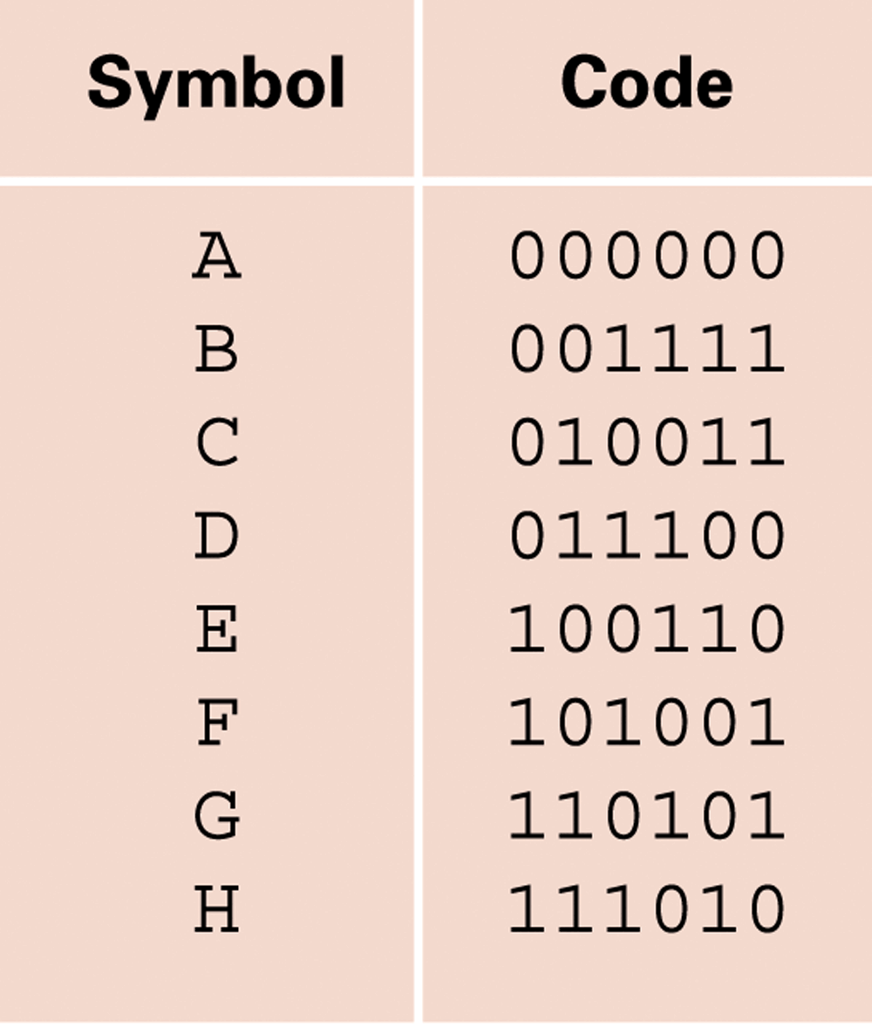
Figure 1.30 An error-correcting code

Slide 51
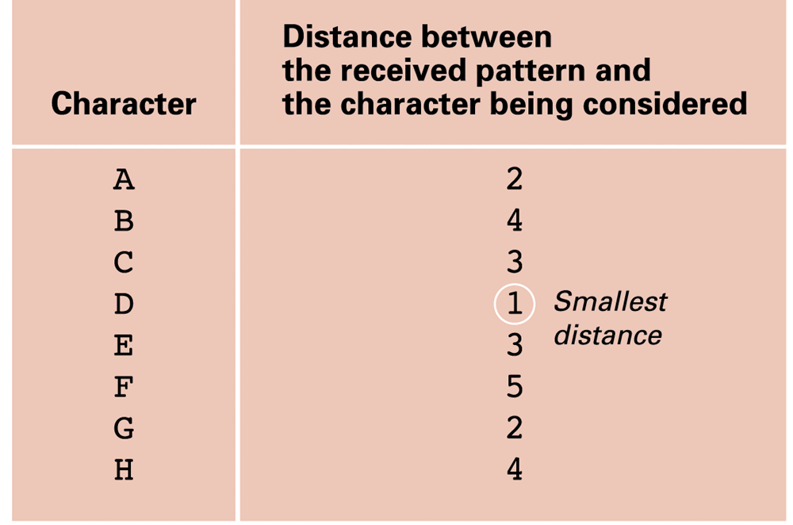
Figure 1.31 Decoding the pattern 010100 using the code in Figure 1.30

